Slide 1
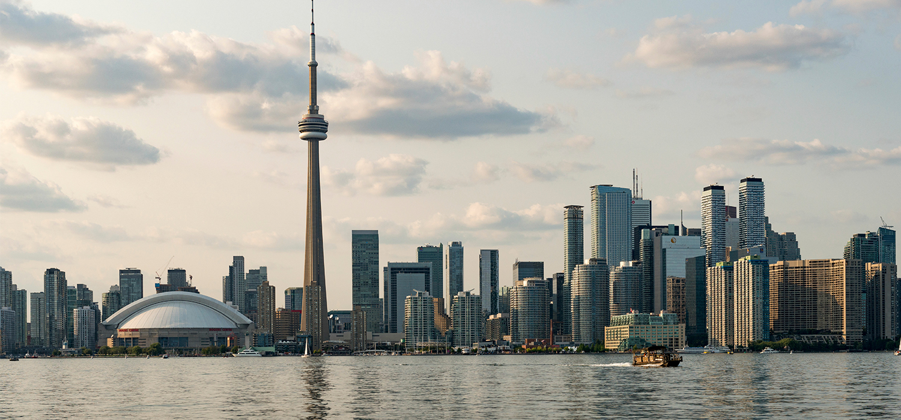

TORONTO CITY
Alba Betanzos
This pitch is aimed at companies in the financial, technological or entrepreneurial sector.

Slide 2

Toronto a Strong Canadian economy
Source: Panamerican World

Slide 3
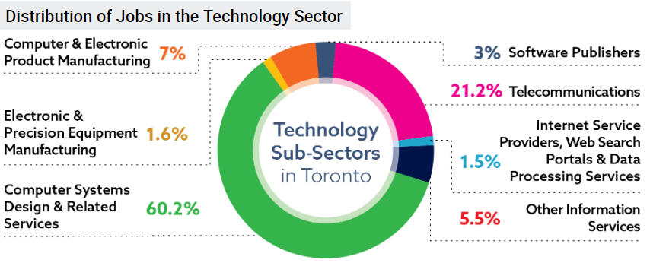
A City Where It Is Easy To Do Business
Source: City of Toronto Business & Economy Industry Sector Support Technology

Slide 4
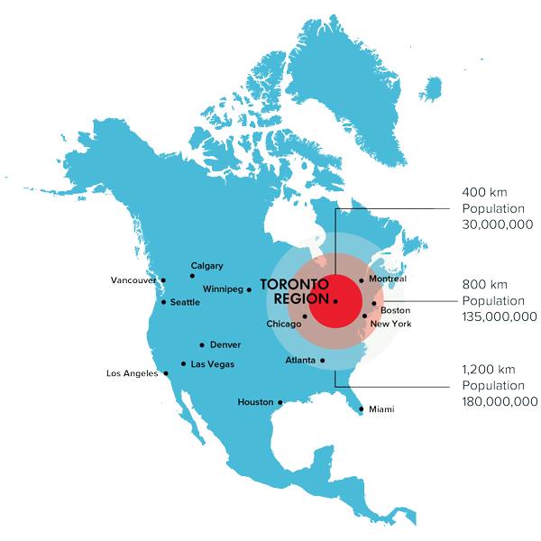
A Strategic Location

Slide 5
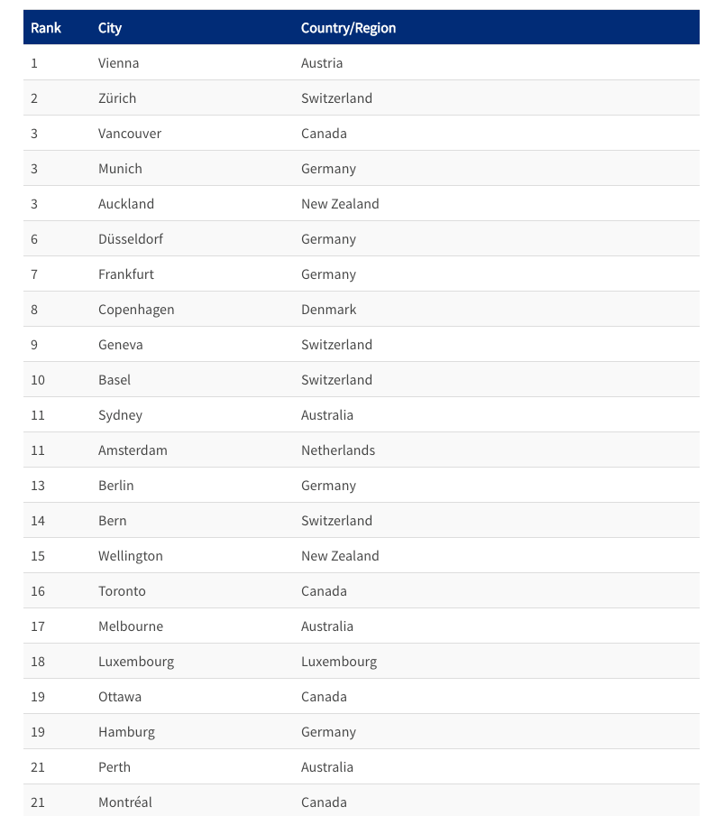
A City With Quality of Life
Source: Quality of Living City Ranking/Mercer

Slide 6
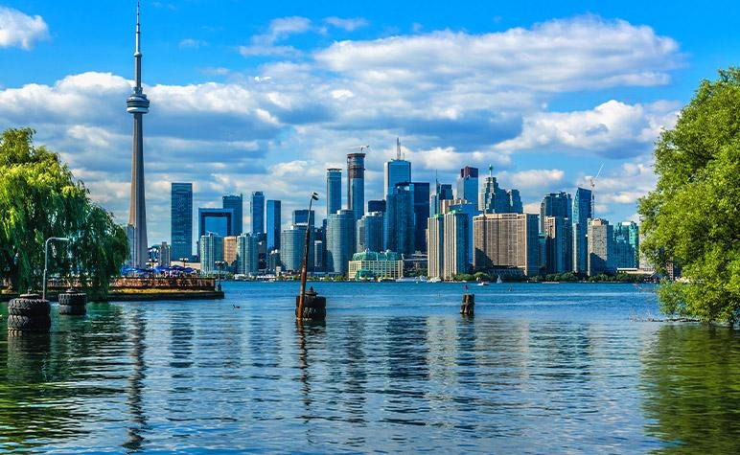
WHY Toronto?
know as the Canadian Business Center
ranks as a leading technology center in the world for the future
a city favorable to entrepreneurship

